Slide 1

To demolish
or
to preserve？
九班-第十五组
汇报：
蒋威 裘旸
胡楠 陆桓锐
文案： 蒋威 裘旸 胡楠
PPT制作：陆桓锐

Slide 2


menu
The introduction and our views
The influence of ancient buildings on the development of modern cities
The effective ways and the examples

Slide 3

01
The introduction

Slide 4

introduction
引言
With the development of Cities in China,
随着中国城市的发展，城市的规模不断扩张。但这给历史和文化建筑带来了重大危机。
the scale of cities continues to expand. But
this has created a major crisis for historical and cultural buildings.
Many old and historic buildings are well protected in China. However, city planners always have to face the question whether old buildings should be demolished to make way for progress.
在中国，许多古老的历史建筑得到了很好的保护。然而，城市规划者总是不得不面对是否应该拆除旧建筑以让位于发展的问题。

Slide 5
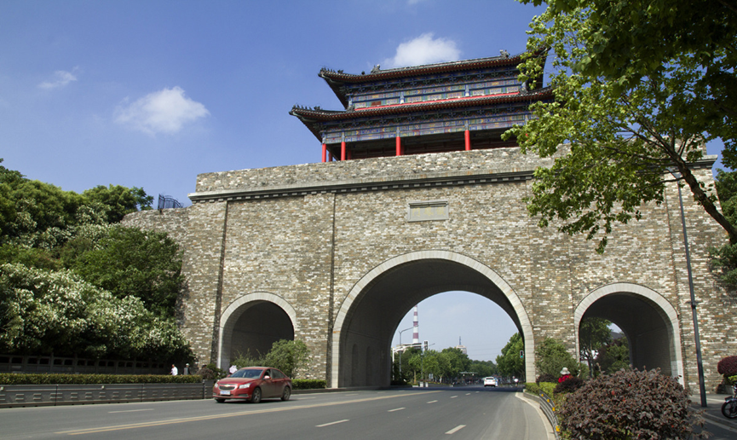

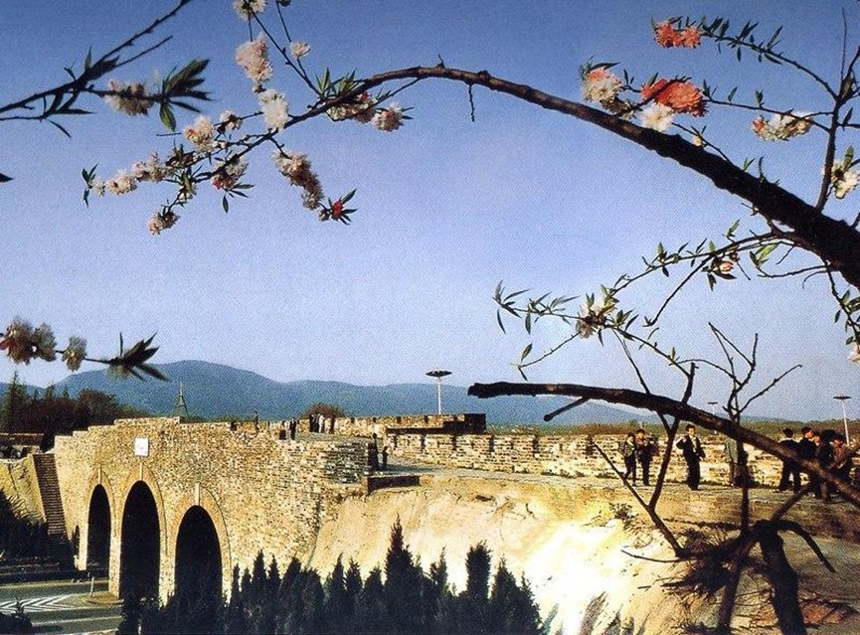
Nanjing ancient city wall
南京古城墙
Nanjing ancient city wall was built during the Ming Dynasty between 1366 and 1386.It is not only the largest city wall in China, but also the largest city wall in the world, and was selected as the world’s largest city wall by the World Records Association.In 1988, Nanjing ancient city wall was recognized as a national key cultural relics protection unit.
南京古城墙建于明朝1366年至1386年间。它不仅是中国最大的城墙，也是世界上最大的城墙，并被世界纪录协会选为世界上最大的城墙。1988年，南京古城墙被认定为全国重点文物保护单位。

Slide 6
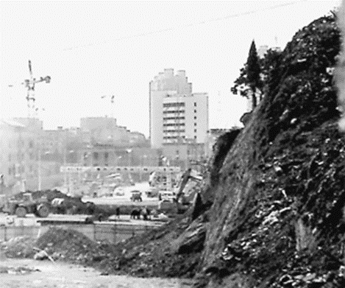
Nanjing ancient city wall
南京古城墙
But the city walls were also once demolished.On March 9, 2014, a large number of ancient city wall bricks were found in the demolition ruins of Meiyuan New Village(梅园新村) and Nanwei Lane（南卫巷） in Nanjing. And some of them were tragically damaged during the demolition and construction process.
2014年3月9日，在南京梅园新村和南卫巷的拆迁废墟中发现了大量古城墙砖。

Slide 7
There is sufficient factual evidence to prove that
In the 1950s and 1960s, A large number of ancient buildings have been demolished in China.
And our view is that
Chinese ancient building should be preserved.
We can find a balance between urbanization and preservation of ancient buildings, instead of demolish them ruthlessly.

Slide 8
02
The influence

Slide 9

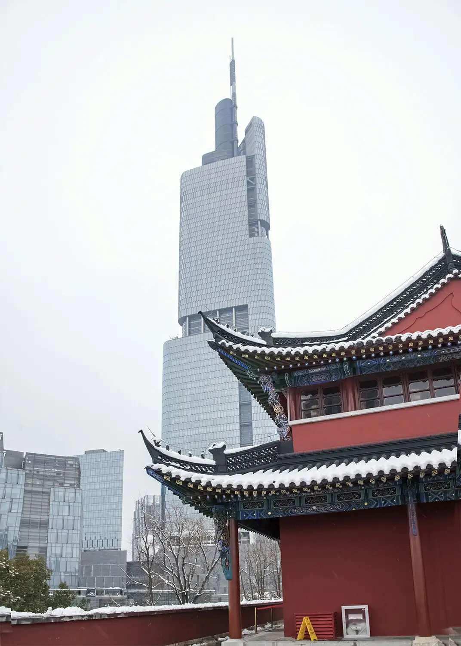
Economic impact
Own historical and cultural ancient architecture itself can promote the awareness of the city, through with the help of the local architecture has a long cultural history, and the overall impact of the city's environmental benefits for investment promotion and capital introduction, and promote the construction of city, ornamental value lead to the development of tourism industry, brings the development of the academic research value, and gradually penetrate in other ways, so as to promote urban economic development.

Slide 10

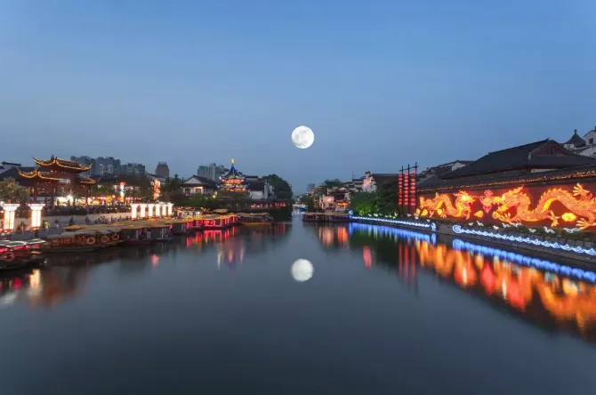
Cultural influence
Chinese ancient architecture is an important material heritage in the history of human development. It is the most powerful evidence of the prosperity of a city and the landmark building of a city. Its historical culture is a symbol of the spiritual civilization of a city. As a landmark of the city, its historical culture, architectural aesthetics and other values are more and more worthy of our attention and protection.

Slide 11

Conclusion
结论
With the progress and development of modern society, the aesthetic, humanistic and historical value of ancient architecture is also constantly explored. At the same time, ancient architecture has played an immeasurable role in the development of urban tourism. As a landmark building of the city, it has a deep influence on the development of the city in economy, culture, art and other aspects. Generally speaking, ancient architecture plays an important role in the development of the city where it is located. As a human heritage, the architectural concept and cultural value contained in it promote the progress of human architecture, and it has an important reference value for modern architecture.
作为人类遗产，其中包含的建筑理念和文化价值促进了人类建筑的进步，并对现代建筑具有重要的参考价值。

Slide 12

Therefore,transforming ancient buildings into tourist attractions is an effective way to balance between city development and the protection of ancient buildings.

Slide 13
03
There are two successful examples

Slide 14

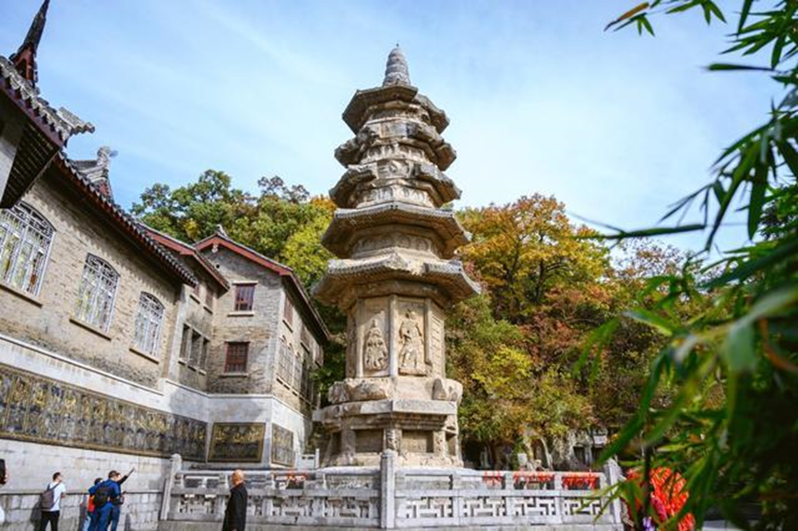
Qixia Temple
Qixia Temple is located at the western foot of the middle peak of Qixia Mountain. Qixia Mountain has a beautiful ecological environment and is known as "the first Mingxiu Mountain in Jinling". In history, many scholars, emperors and generals visited here.

Slide 15
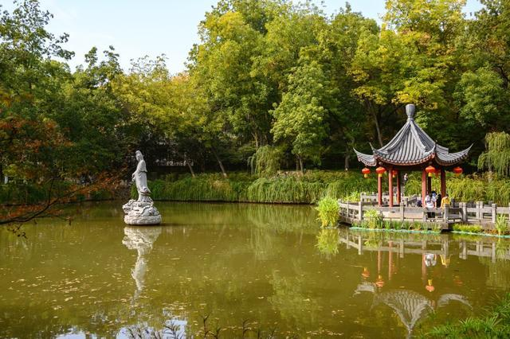
Qixia Temple
栖霞寺
During the War of Resistance, it sheltered over 20,000 civilians from the flames of war. After the founding of the People’s Republic of China, the government funded the renovation of most of the temples and turned the surrounding area into qixia Mountain Scenic area, which not only protected the ancient buildings but also brought abundant revenue for the city’s development.

Slide 16
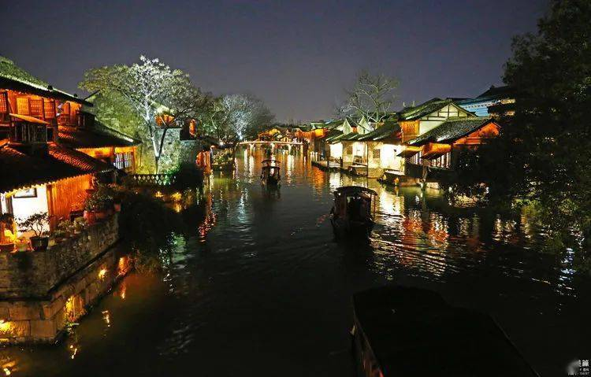
Wuzhen Town
Wuzhen,located in Jiaxing City, Zhejiang Province,is a famous historical and cultural town in China. Wuzhen repaired damaged old streets and houses with old materials and traditional craftsmanship and restored or rebuilt of parts of old buildings.

Slide 17
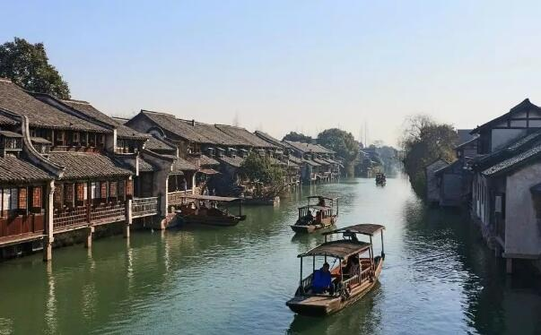
Wuzhen Town
Wuzhen well restored and maintained the original appearance of the ancient town, perfectly shows the beauty of Jiangnan Water Town. When it rains, the hazy beauty seems to be in the ink painting.

Slide 18

All in all,it is a good choice to preserving ancient buildings as tourist attractions forfinding a balance between urbanization and preservation of ancient buildings.

Slide 19
Questions
1、Which examples were introduced?
2、What are the aspects of the influence of ancient buildings?

Slide 20
Thanks for
watching

